Slide 1
Function as a Service
Pravin Y Pawar

Slide 2
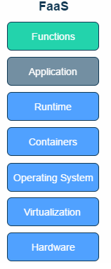
What is FaaS (Function-as-a-Service)?
A type of cloud-computing service that
allows to execute code
in response to events
without the complex infrastructure
typically associated with building and launching microservices applications
Hosting a software application on the internet typically requires
provisioning and managing a virtual or physical server
managing an operating system and web server hosting processes
With FaaS, the physical hardware, virtual machine operating system, and web server software management are all handled automatically by cloud service provider
allowing developers to focus solely on individual functions in application code

Slide 3
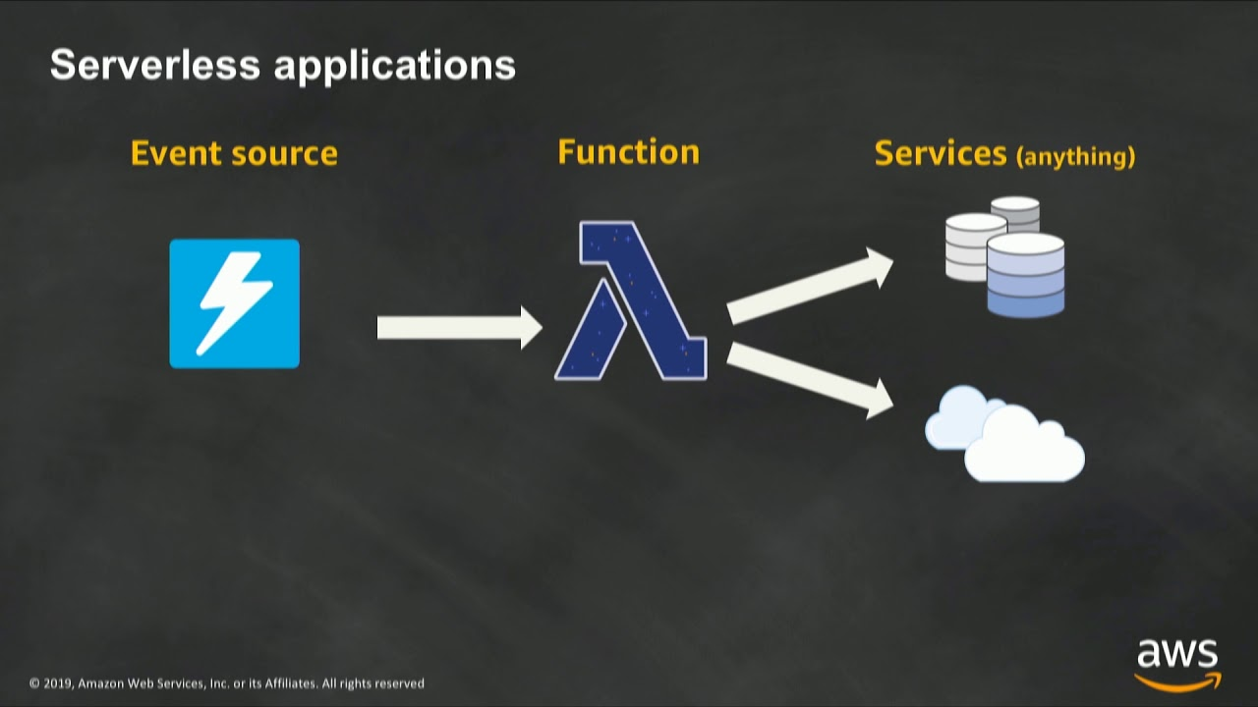
Characteristics of FaaS
No server management or maintenance needed
Stateless
Automatic scaling, fine grained to number of requests
Runs only when needed (triggered by events such as requests)

Slide 4
Benefits of FaaS
FaaS is a valuable tool if you’re looking to efficiently and cost-effectively migrate applications to the cloud.
Focus more on code, not infrastructure:
With FaaS, can divide the server into functions that can be scaled automatically and independently so don’t have to manage infrastructure
This allows to focus on the app code and can dramatically reduce time-to-market
Pay only for the resources you use, when you use them:
With FaaS, you pay only when an action occurs
When the action is done, everything stops—no code runs, no server idles, no costs are incurred
FaaS is, therefore, cost-effective, especially for dynamic workloads or scheduled tasks
FaaS also offers a superior total-cost-of-ownership for high-load scenarios
Scale up or down automatically:
With FaaS, functions are scaled automatically, independently, and instantaneously, as needed
When demand drops, FaaS automatically scales back down
Get all the benefits of robust cloud infrastructure:
FaaS offers inherent high availability because it
is spread across multiple availability zones per geographic region
can be deployed across any number of regions without incremental costs

Slide 5
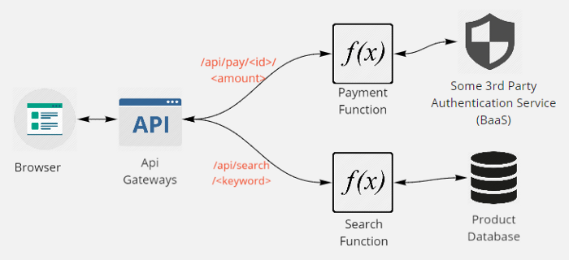
Serverless Architecture
Source : medium

Slide 6
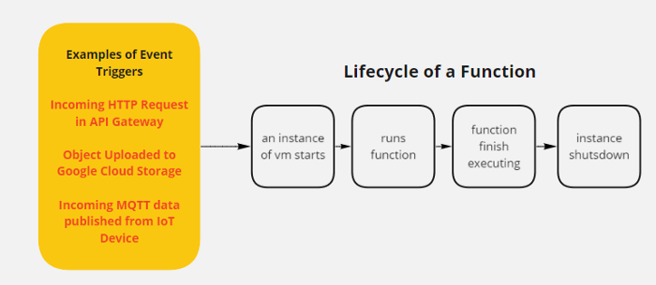
How it works?
Source : medium

Slide 7
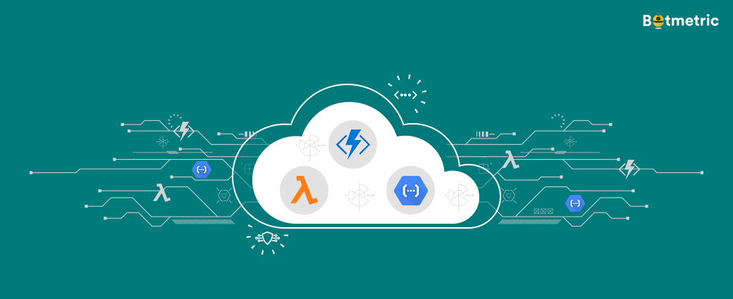
FaaS vs Serverless
Serverless and Functions-as-a-Service (FaaS) are often conflated with one another
but the truth is that FaaS is actually a subset of serverless
Serverless is focused on any service category
be it compute, storage, database, messaging, API gateways, etc.
where configuration, management, and billing of servers are invisible to the end user
FaaS, is focused on the event-driven computing paradigm
while perhaps the most central technology in serverless architectures
wherein application code, or containers, only run in response to events or requests

Slide 8
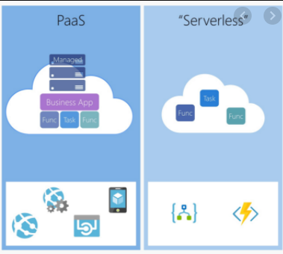
PaaS vs FaaS
PaaS is very similar to FaaS
except that that it does not triggered by event
is typically always on
This does not suit the serverless framework
Characteristics
No server management or maintenance needed
Stateless
Automatic scaling, adjustable to number of instances running
Typically runs 24/7
Sounds very similar to FaaS right?
However there is one key operational difference between the both of them:
Scalability, which affects operating cost.
Source : stackify

Slide 9
Thank You!
In our next session:

